Slide 1
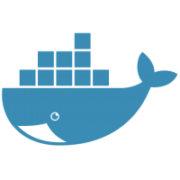
Docker - Hands-on
2015-2016

Slide 2

Agenda
Containers - A Primer
Docker : Overview
Hands-on Sessions
Lots of Q&A
Goal → Go back and put Docker to work

Slide 3

Linux Application Containers are changing the way people develop, deploy and run applications

Slide 4

What is a Container?
Lightweight Linux Environment
Hermetically sealed (Isolated)
Deployable application
Introspectable
Runnable artefact
Recently popularised by Docker

Slide 5
Containers : A Primer
This is vanilla virtualization
Guest environment
app code
libraries
guest OS
Hypervisor

Slide 6
Containers : A Primer
It has downsides:
No Isolation
Guest environment
app code
app code
???
dependency
libraries
guest OS
Hypervisor

Slide 7
Containers : A Primer
It has downsides:
Little Reuse
Guest environment
Guest environment
Guest environment
app code
app code
app code
libraries
libraries
libraries
redundant
guest OS
guest OS
guest OS
Hypervisor

Slide 8

Containers : A Primer
Containers create a better abstraction layer
Guest environment
app code
libraries
cut here
guest OS
Hypervisor

Slide 9
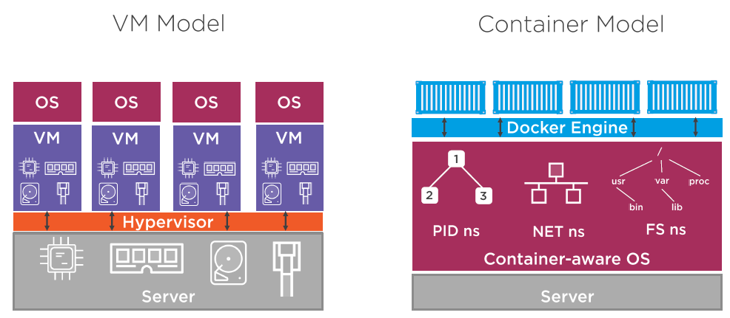
Containers : A Primer

Slide 10
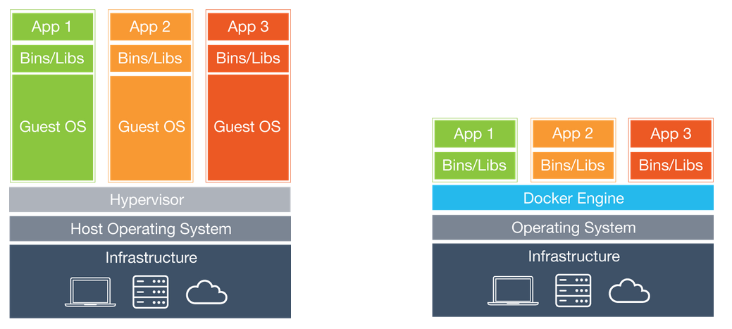
Containers vs VMs

Slide 11
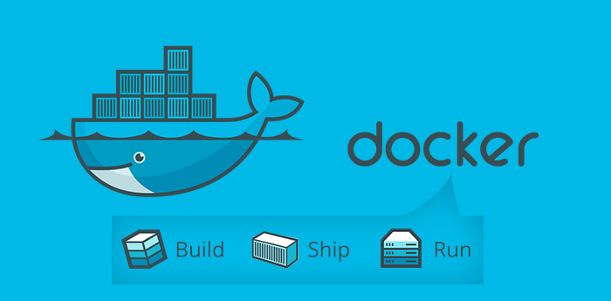
Docker

Slide 12
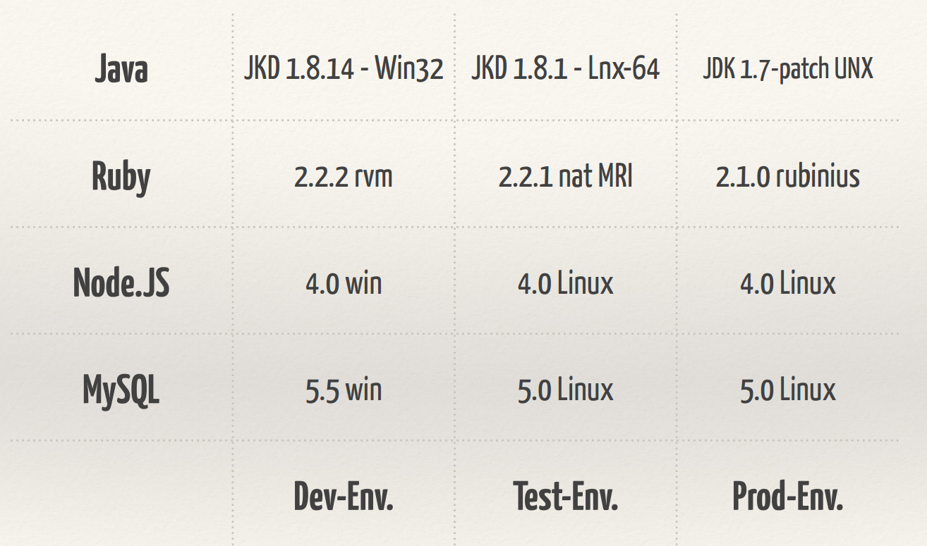
First - The Problem

Slide 13
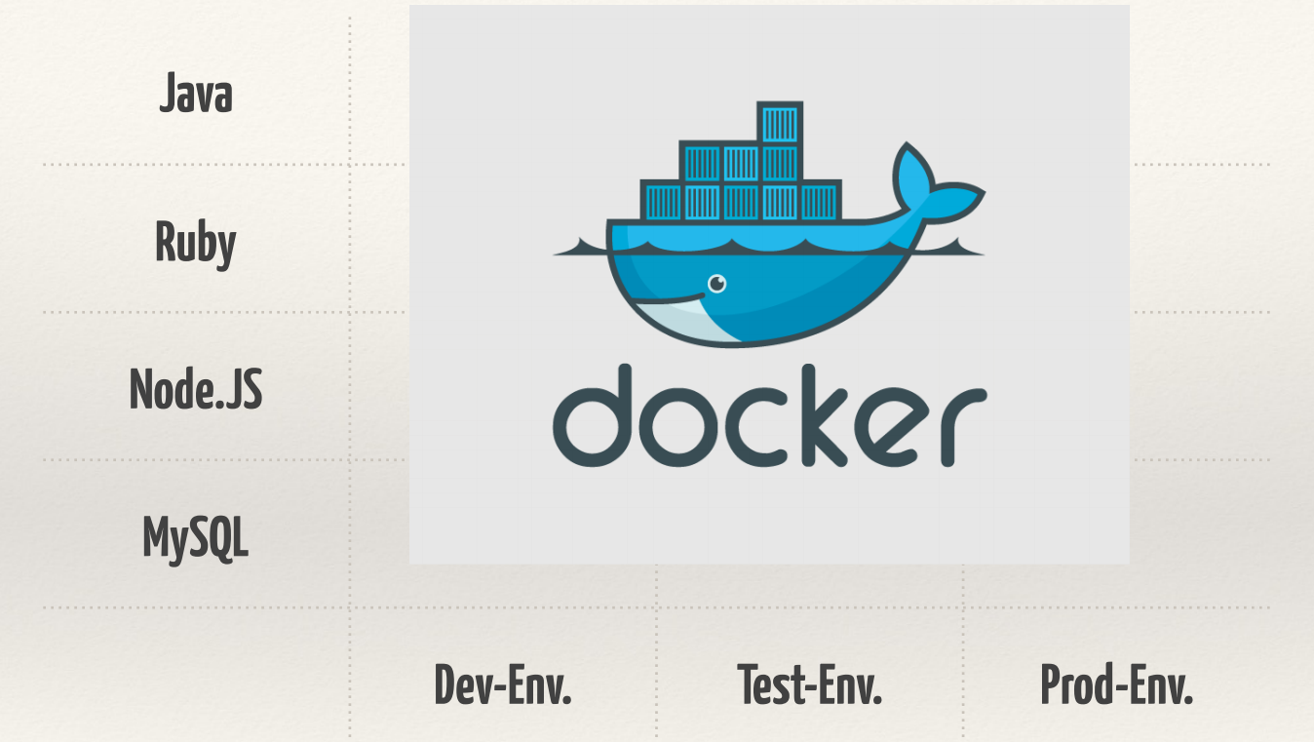
The Solution

Slide 14
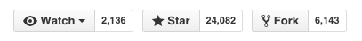
Docker - Who is behind it?
A separate company called Docker Inc.
Container Format
Well supported by all major vendors
All Cloud + Infrastructure providers support it
One of the most successful Open Source Projects
Written in Go Language
Apache Open Source License

Slide 15
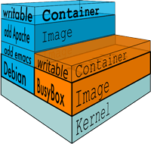
What is Docker?
Allows you to package an application and all its dependencies into a SINGLE STANDARDIZED unit.
Docker Image → Code, Runtime, System Tools, etc.
As a result you can run this same image, regardless of the environment

Slide 16
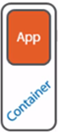
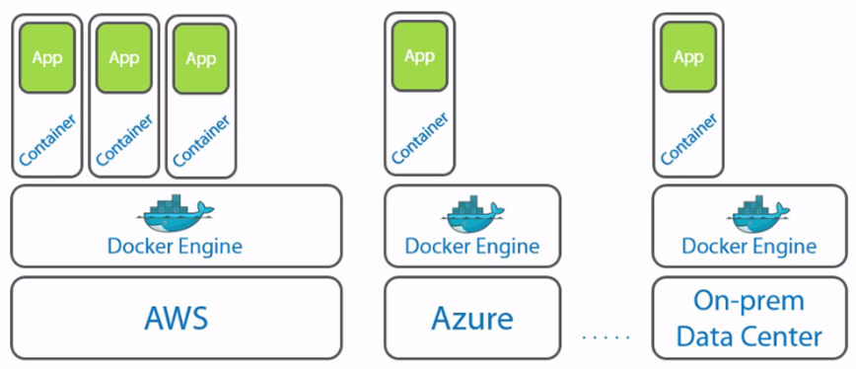
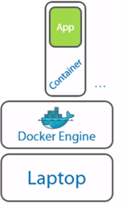
App Portability

Slide 17
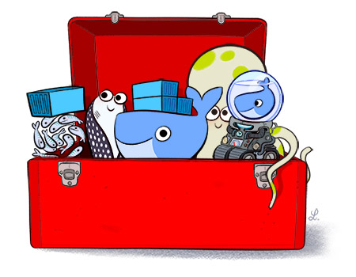
Docker Ecosystem
A Platform to Ship + Build + Run anywhere
Docker Engine
Docker Client
Docker Hub
Docker Machine
Docker Compose
Docker Swarm
Kitematic
Docker Toolbox

Slide 18
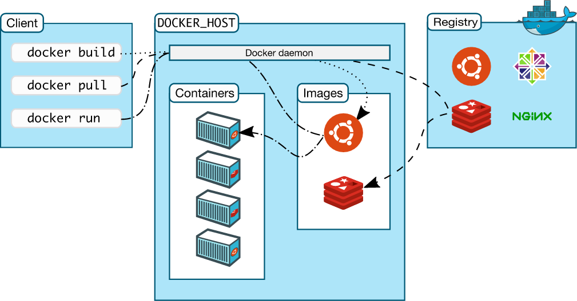
Docker Components
2
3
Docker Daemon
Docker Client
Docker Hub (Registry of Images)
Public Registry
Private Registry is also possible
1

Slide 19
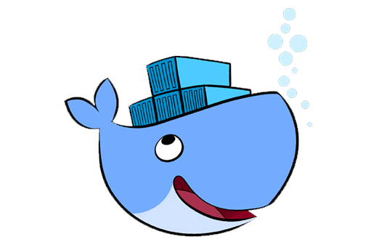
Docker Engine
A lightweight runtime that runs your Docker containers
Runs on Linux
Creates an Operating Environment for your application
Has a daemon that accepts commands from the Docker client
Executes commands for
Build, Ship and Run Images/Containers

Slide 20

Hands-on Labs : Docker
Session 1 : Installation of Docker Toolbox
Session 2 : Learn Docker commands
Session 3 : Docker Hub
Session 4 : Build your own Docker Image
Session 5 : Writing a Docker File

Slide 21
Session 1 : Setup – Docker Toolbox
Understand what we have installed
Docker Machine : Allows you to create / manage multiple Docker Hosts
A Docker Machine(Host) runs the Docker Daemon (Engine)
Docker Client can be configured to point to any Host i.e. Machine
Hands-on: Use Docker Machine to start/stop Docker Machines, point Docker Client to it and try out a few commands. Refer to document : Docker ToolboxSetup-Windows.pdf and go to section Docker Machine commands.

Slide 22
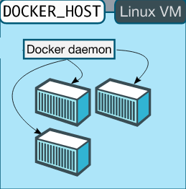
Docker Machine - New Architecture
Windows
docker.exe (Docker Client)
docker-machine.exe (Docker Machine)
Docker Machine 1
Docker Machine 2
Docker Machine n

Slide 23
Bonus: Run your first Docker container
docker run busybox
docker run busybox date
docker run busybox ls
docker -it busybox

Slide 24
Session 2 : Basic Docker Commands
Learn more about Docker commands
Primarily use the Docker client
Manage Images
Pull / List
Create Containers
Interactive
Background
Remove / Restart
List
Hands-on: Try out the commands

Slide 25


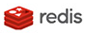
Docker Hub
Cloud Hosted Service from Docker
Public and Private Repositories
Thousands of public and official Docker Images
Automate Builds
API Hooks
Local Registry Option also available
Docker Trusted Registry

Slide 26
Session 3 : Docker Hub
Public Repository of Images (Web)
You can get an account too !
Pull any repository
Push your own repositories
Option : Private Registry
docker push/pull commands by default work against the public registry.
Hands-on: Try out the Docker Hub

Slide 27
Session 4 : Building our own Images
We need to distribute our own Image
Image would contain
Specific OS version
Any app software installed
Any other files/configuration, etc.
Hands-on: Build your first image

Slide 28
Session 5 : Writing your own Dockerfile
Script your own Dockerfile
Set of instructions
OS
System Software
Application Software
Setup Script
Ports / Volumes
Default Commands to run when Container starts
Hands-on: Write a Dockerfile

Slide 29
What can you do with Docker?
Dev – Test - Deploy
Software
Evaluation
Hardware Resources
Running Alternate OS

Slide 30
Start Thinking !!!
Imagine if you had to test some software
Imagine if you had to evaluate an OS
Imagine if you had to run ubuntu, debian and more on your Windows box
Imagine if you want to be sure that if it runs in dev, it runs in production !
Streamline and Reduce inefficiencies in Build, Test, Deploy cycles

Slide 31
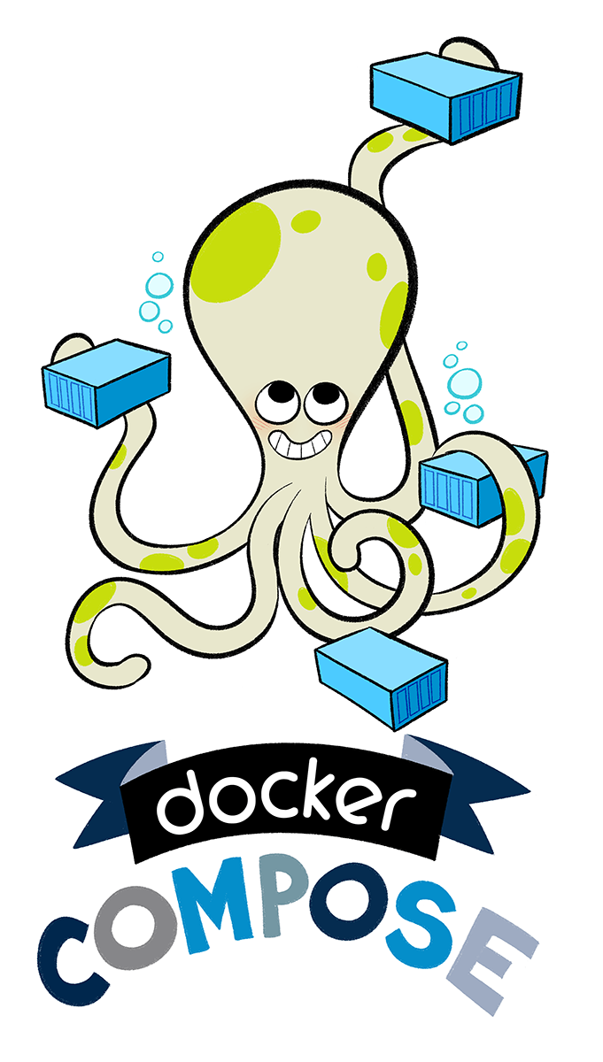
Docker Compose

Slide 32
Docker Compose
Tool for defining and running multi-container Docker applications.
Part of the Docker Toolbox
Tool name : docker-compose
Simple commands to start, stop the multi-container app
Multi-container app definition is provided in a YAML (.yml) file

Slide 33
Docker Compose
Think of multi-container applications as made up of services
For e.g. Web Application can be broken down into: Web + Database
One service depends on the other
Docker Compose takes care of starting the services in the correct order

Slide 34
Docker Compose – Getting Started
Think of multi-container applications as made up of services
For e.g. Web Application can be broken down into: Web + Database
One service depends on the other
Docker Compose takes care of starting the services in the correct order

Slide 35
Sample docker-compose.yml
version: '2'
services:
web:
build: .
ports:
- "5000:5000"
depends_on:
- redis
redis:
image: redis
ports:
- "6379:6379"

Slide 36
Docker Compose
Hands-on

Slide 37
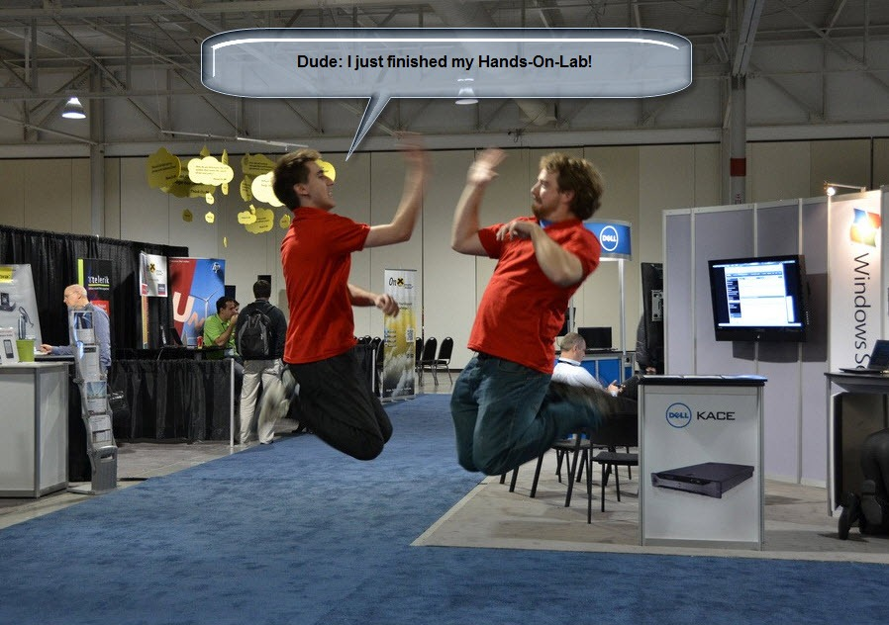

Slide 38
Docker License
Open Source Apache 2.0 License
All is Well !

Slide 39
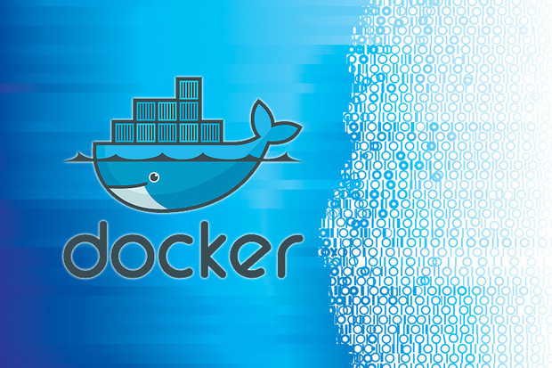
Thank You

Slide 40
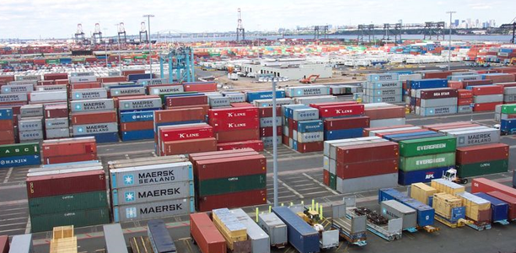
Designing Applications at Scale

Slide 41
Designing Scalable Applications
Top 3 hurdles of designing scalable applications: 1. The app (how to build, package, and distribute it) 2. The infra (how you manage the complexities that come with scalable application)
3. The wild (how you deal with living, evolving code in production)

Slide 42

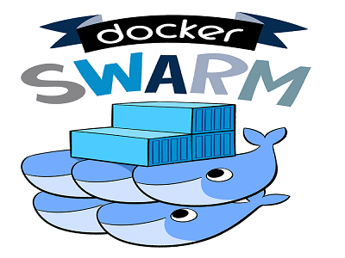
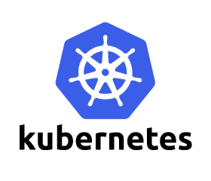
Designing Scalable Applications
You have seen Docker
But if you scale out to multiple containers, then you have multiple issues to take care of
Let’s discuss them
Orchestration Tools

Slide 43
Scheduling
Health
Discovery
But that's just one machine!
Monitoring
Configuration
Scaling
Security

Slide 44
Scaling Concerns
We need to know that our container are up and running.
If they’re not we need to restart them.
We need to be able to access containers when they come online.
We need containers to be able to talk to each other.
We need a safe and secure way to handle sensitive data.

Slide 45
And more … Scaling Concerns
Isolation: Keep jobs from interfering with each other
Scheduling: Where should my job be run?
Lifecycle: Keep my job running
Discovery: Where is my job now?
Constituency: Who is part of my job?
Scale-up: Making my jobs bigger or smaller
Auth{n,z}: Who can do things to my job?
Monitoring: What’s happening with my job?
Health: How is my job feeling?

Slide 46

Cattle vs Pets
Pet
Cattle
Has a name
Is unique or rare
Personal Attention
If it gets ill, you make it better
Has a number
One is much like any other
Run as a group
If it gets ill, you make hamburgers
Notes:
And you can see the obvious analogies to servers here. We’ve been woken up to deal with a sick pet-server. We’ve all been really proud of ourselve when we’ve figured out that we needed 12 of this type of machine, so we named them after the zodiac. It’s okay. We’ve all done it. It’s understandable.

Slide 47
Desired State

Slide 48
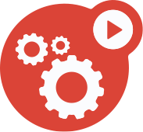


Desired States
./create_docker_images.sh
./launch_frontend.sh x 3
./launch_services.sh x 2
./launch_backend.sh x 1
Notes:
Under an imperative system, you have a series of tasks. Create images, 3 frontends, create 2 services, etc.

Slide 49

Desired States
./create_docker_images.sh
./launch_frontend.sh x 3
./launch_services.sh x 2
./launch_backend.sh x 1
Notes:
If something dies, something has to react. Under your worst case it’s an admin that has to react. Maybe you have something automated.

Slide 50
Desired States
There should be:
3 Frontends
2 Services
1 Backend
Notes:
Under a desired state, you just say this is what I want, 3, 2, 1.
Then if something blows up, you’re no longer in the desired state, so Kubernetes will fix it.

Slide 51
Employees Not Children

Slide 52
Children vs Employees
Child
Employee
Go upstairs
Get undressed
Put on pajamas
Brush your teeth
Pick out 2 stories
Go get some sleep
Notes:
So you tell an employee or co-worker to go home and get some sleep, and that’s all you have to do. But you have to tell child everything in this rote set of steps. And those of you who don’t have children might be wondering, do you really have to tell them to go upstairs? YES otherwise you end up with a naked child in your living room.
And this is like just sequential scripts. If you miss a key step you end up seeing things you wish you hadn’t.

Slide 53
Pods

Slide 54
Pods
10.10.1.100
Logical Application
One or more containers and volumes
Shared namespaces
One IP per pod
Pod
nginx
monolith
GCE
iSCSI
NFS
Notes:
A pod is the unit of scheduling in Kubernetes. It is a resource envelope in which one or more containers run. Containers that are part of the same pod are guaranteed to be scheduled together onto the same machine, and can share state via local volumes.
Kubernetes is able to give every pod and service its own IP address. This removes the infrastructure complexity of managing ports, and allows developers to choose any ports they want rather than requiring their software to adapt to the ones chosen by the infrastructure. The latter point is crucial for making it easy to run off-the-shelf open-source applications on Kubernetes--pods can be treated much like VMs or physical hosts, with access to the full port space, oblivious to the fact that they may be sharing the same physical machine with other pods.

Slide 55
Health Checks

Slide 56
Monitoring and Health Checks
Node
Kubelet
Pod
Pod
app v1
Notes:
On every node is a daemon called a Kubelet. One of the Kubelet’s jobs is to ensure that pods are healthy.

Slide 57
Monitoring and Health Checks
Hey, app v1... You alive?
Node
Kubelet
Pod
app v1
app v1
Notes:
Kubelets do this by sending out a probe that pods respond to.

Slide 58
Monitoring and Health Checks
Node
Kubelet
Pod
Nope!
app v1
app v1
Notes:
If the Kubelet gets back multiple bad responses

Slide 59
Monitoring and Health Checks
OK, then I’m going to restart you...
Node
Kubelet
Pod
app v1
app v1
Notes:
It restarts the Pod.

Slide 60
Monitoring and Health Checks
Node
Kubelet
Pod

Slide 61
Monitoring and Health Checks
Node
Kubelet
Pod
app v1

Slide 62
Monitoring and Health Checks
Hey, app v1... You alive?
Node
Kubelet
Pod
app v1
Notes:
This cycle then starts all over again.

Slide 63
Monitoring and Health Checks
Node
Kubelet
Pod
Yes!
app v1
Notes:
And, hopefully, this time the app is functioning properly.

Slide 64
Services

Slide 65
Services
Service
Pod
Pod
Pod
hello
hello
hello
Notes:
Okay, so we’ve been talking about how containers are cattle, and we don’t care about them. But at some level we do. We don’t care which Pod serves up a particular request, but we have to get one of them to do it. How do we map this thing we don’t have a lot of regard for, to something we do - services.
Services denote names we give to certain collection of pods so that we can map frontend-deployment-715099486-dj49s to frontend request.
Kubernetes supports naming and load balancing using the service abstraction: a service has a name and maps to a dynamic set of pods defined by a label selector. Any container in the cluster can connect to the service using the service name. Under the covers, Kubernetes automatically load-balances connections to the service among the pods that match the label selector, and keeps track of where the pods are running as they get rescheduled over time due to failures.

Slide 66
Services
Persistent Endpoint for Pods
Service
Pod
Pod
Pod
hello
hello
hello

Slide 67
Services
Persistent Endpoint for Pods
Use Labels to Select Pods
Service
Pod
Pod
Pod
hello
hello
hello
Notes:
How do we do this? Labels.
Labels are arbitrary key-value pairs that we can add to any pod.

Slide 68
Labels
Pod
Pod
Arbitrary meta-data attached to Kubernetes object
hello
hello
labels: version: v1
track: stable
labels: version: v1
track: test
Notes:
Let’s talk about labels for a second. This is how Kubernetes does grouping. Kubernetes supports labels which are arbitrary key/value pairs that users attach to pods (and in fact to any object in the system). Users can use additional labels to tag the service name, service instance (production, staging, test), and in general, any subset of their pods. A label query (called a “label selector”) is used to select which set of pods an operation should be applied to. Taken together, labels and deployments allow for very flexible update semantics.

Slide 69
Labels
Pod
Pod
selector: “version=v1”
hello
hello
labels: version: v1
track: stable
labels: version: v1
track: test

Slide 70
Labels
Pod
Pod
selector: “track=stable”
hello
hello
labels: version: v1
track: stable
labels: version: v1
track: test

Slide 71
Services
Persistent Endpoint for Pods
Use Labels to Select Pods
Internal or External IPs
Service
Pod
Pod
Pod
hello
hello
hello
Notes:
By default, Kubernetes objects are only reachable from within their cluster -- these services are of type ClusterIP by default. This applies to services, as well. But Services also support externally visible IP addresses as well. As of the time of this writing, there are two external types: LoadBalancer and NodePort. A service of type LoadBalancer will round robin traffic to all of it’s targetted pods (like in the slide on screen). A service of type NodePort will open use the node’s IP address and a port given by the service to open up a communication pathway with your app.

Slide 72
Deployments

Slide 73
Drive current state towards desired state
Deployments
app: hello
replicas: 1
Node1
Node2
Node3
Pod
hello
Notes:
Until now, we haven’t really talked about machines. In my opinion, that’s one of the great things about Kubernetes -- it lets you focus on what really matters: the application. But, applications (or Pods in Kuberntes lingo) have to run on machines. You saw before that when we launched a Pod, Kubernetes assigned it to a machine (or Node in Kubernetes lingo) for us. Still, it would be nice if we didn’t have to launch Pods directly. To that end, Kubernetes gives us another structure called “Deployments”. Deployments understand “desired state”. Ie, we specify how many replicas we want of our application and a deployment will actively monitor our pods and make sure we always have enough running. On screen we have three Nodes and one Pod. Since we’ve only specified that we want one of our Pods running, all is good in the world.

Slide 74
Drive current state towards desired state
Deployments
app: hello
replicas: 3
Node1
Node2
Node3
Pod
hello
Notes:
If we were to specify that we want 3 versions of our app running (possibly using `kubectl apply`), the Deployment would notice that our desired state doesn’t match our current state and work to rectify the problem.

Slide 75
Drive current state towards desired state
Deployments
app: hello
replicas: 3
Node1
Node2
Node3
Pod
Pod
Pod
hello
hello
hello

Slide 76
Drive current state towards desired state
Deployments
app: hello
replicas: 3
Node1
Node2
Node3
Pod
Pod
hello
hello
Notes:
If a Pod we’re to disappear for any reason (such as in the example above, where a Node went down, taking the Pod with it), the deployment would notice that and try to schedule a new Pod on one of the available machines.

Slide 77
Drive current state towards desired state
Deployments
app: hello
replicas: 3
Node1
Node2
Node3
Pod
Pod
Pod
hello
hello
hello

Slide 78
Rolling Updates

Slide 79
Rolling Update
Service
Node1
Node2
Node3
Pod
Pod
Pod
app v1
app v1
app v1
ghost
ghost
Notes:
So it happened - the code has changed. Now what do we do? We update it. When it comes to deploying code, we want to avoid downtime at all costs. We want to be able to cautiously rollout changes and, if necessary, be able to quickly roll back to a working state. Some design patterns in the space have evolved: namely Blue/Green and Canary deployments. Kubernetes can handle both but let’s take a second to see the built-in RollingUpdate strategy of Deployments. RollingUpdates allow us to rollout a new version of a Pod, while keeping the old version around. As we are scaling up the new version of our Pods, *both* will still be getting traffic. This allows us to cautiously test that the new version works as expected. And, if it doesn’t, we can stop the update and rollback to the version we had before. The next couple of slides show this in action.

Slide 80
Rolling Update
Service
Node1
Node2
Node3
Pod
Pod
Pod
Pod
app v1
app v1
app v1
ghost
ghost
app v2
Notes:
First we create a new version of our Pod.

Slide 81
Rolling Update
Service
Node1
Node2
Node3
Pod
Pod
Pod
Pod
app v1
app v1
app v1
ghost
ghost
app v2
Notes:
The the Service pics it up and start routing traffic to the new Pod.

Slide 82
Rolling Update
Service
Node1
Node2
Node3
Pod
Pod
Pod
Pod
app v1
app v1
app v1
ghost
ghost
app v2
Notes:
The we unhook on of the old Pods.

Slide 83
Rolling Update
Service
Node1
Node2
Node3
Pod
Pod
Pod
app v1
app v1
ghost
app v2
Notes:
Finally, we get rid of it.

Slide 84
Rolling Update
Service
Node1
Node2
Node3
Pod
Pod
Pod
Pod
app v1
app v1
app v2
ghost
app v2
Notes:
This cycle continues until we’re left with just the desired amount of Pods (all of which will be of our new version).

Slide 85
Rolling Update
Service
Node1
Node2
Node3
Pod
Pod
Pod
Pod
app v1
app v1
app v2
ghost
app v2

Slide 86
Rolling Update
Service
Node1
Node2
Node3
Pod
Pod
Pod
Pod
app v1
app v1
app v2
ghost
app v2

Slide 87
Rolling Update
Service
Node1
Node2
Node3
Pod
Pod
Pod
app v1
app v2
app v2

Slide 88
Rolling Update
Service
Node1
Node2
Node3
Pod
Pod
Pod
Pod
app v2
app v1
app v2
app v2

Slide 89
Rolling Update
Service
Node1
Node2
Node3
Pod
Pod
Pod
Pod
app v2
app v1
app v2
app v2

Slide 90
Rolling Update
Service
Node1
Node2
Node3
Pod
Pod
Pod
Pod
app v2
app v1
app v2
app v2

Slide 91
Rolling Update
Service
Node1
Node2
Node3
Pod
Pod
Pod
app v2
app v2
app v2

Slide 92
Recap

Slide 93
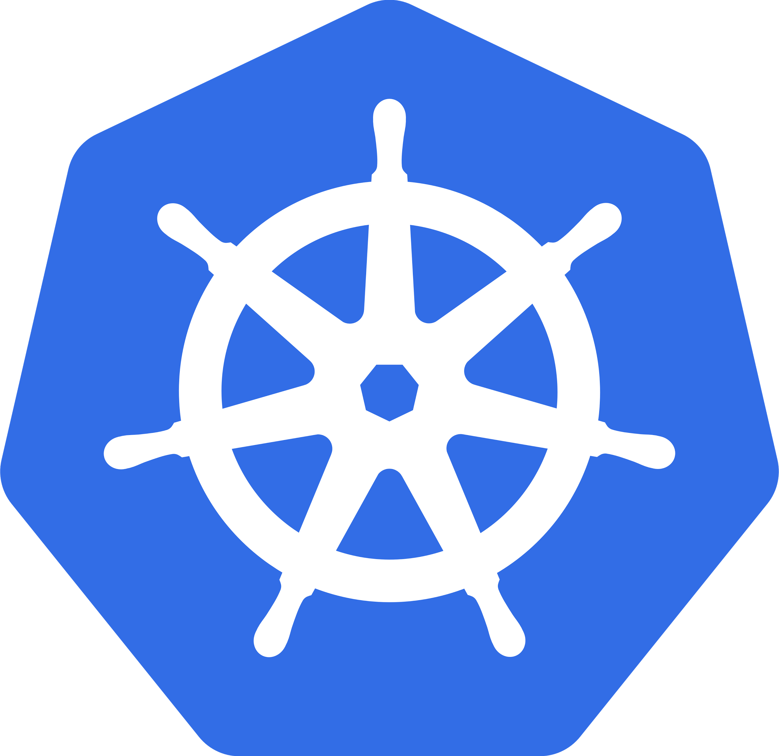
Kubernetes
Manage applications, not machines
Open source, Open API container orchestrator
Supports multiple cloud and bare-metal environments
Inspired and informed by Google’s experiences and internal systems

Slide 94

Container
Subatomic unit in Kubernetes
Can use Dockerfile just like you’re used to

Slide 95
Pods
10.10.1.100
Logical Application
One or more containers and volumes
Shared namespaces
One IP per pod
Pod
nginx
monolith
GCE
iSCSI
NFS

Slide 96
Monitoring and Health Checks
Hey, app v1... You alive?
Node
Kubelet
Pod
app v1
app v1

Slide 97
Secrets and Configmaps
$ kubectl create secret generic tls-certs --from-file=tls/
Kubernetes Master
Node
secret
API
Server
etcd
Kubelet

Slide 98
Services
Persistent Endpoint for Pods
Use Labels to Select Pods
Internal or External IPs
Service
Pod
Pod
Pod
hello
hello
hello

Slide 99
Labels
Pod
Pod
Arbitrary meta-data attached to Kubernetes object
hello
hello
labels: version: v1
track: stable
labels: version: v1
track: test

Slide 100
Drive current state towards desired state
Deployments
app: hello
replicas: 3
Node1
Node2
Node3
Pod
Pod
Pod
hello
hello
hello

Slide 101
Rolling Update
Service
Node1
Node2
Node3
Pod
Pod
Pod
Pod
app v1
app v1
app v1
ghost
ghost
app v2

Slide 102
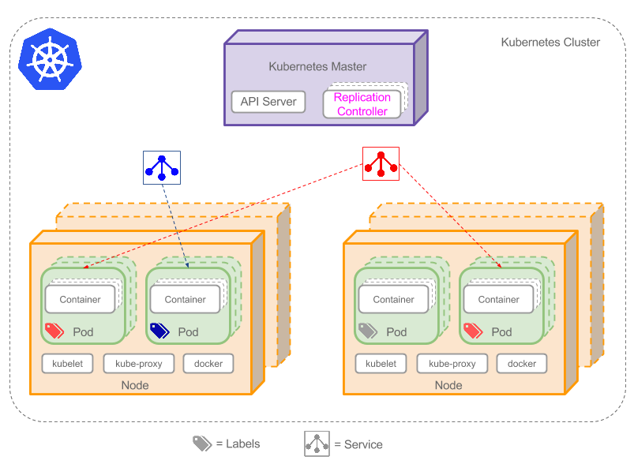

Slide 103
But wait there’s more.
Persistent disks
Logging & Monitoring
Node & Pod Autoscaling
Web UI
Jobs & Daemon Sets
Cluster Federation
Ingress
Notes:
Kubernetes is a large complicated thing. There’s more that it can do than we went through here. We invite you to explore these things as you go forward with Kubernetes. Persistent Disk: Long lived storage
Logging and Monitoring:
Horizontal Pod Autoscaling:
Vertical Node Autoscaling:
Web UI:
Jobs:
Pet Sets:
Daemon Sets:
Cluster Federation: Ingress (L7 networking):

Slide 104
Appendix : Extra Session

Slide 105
Docker Build-Ship-Run
Demo

Slide 106
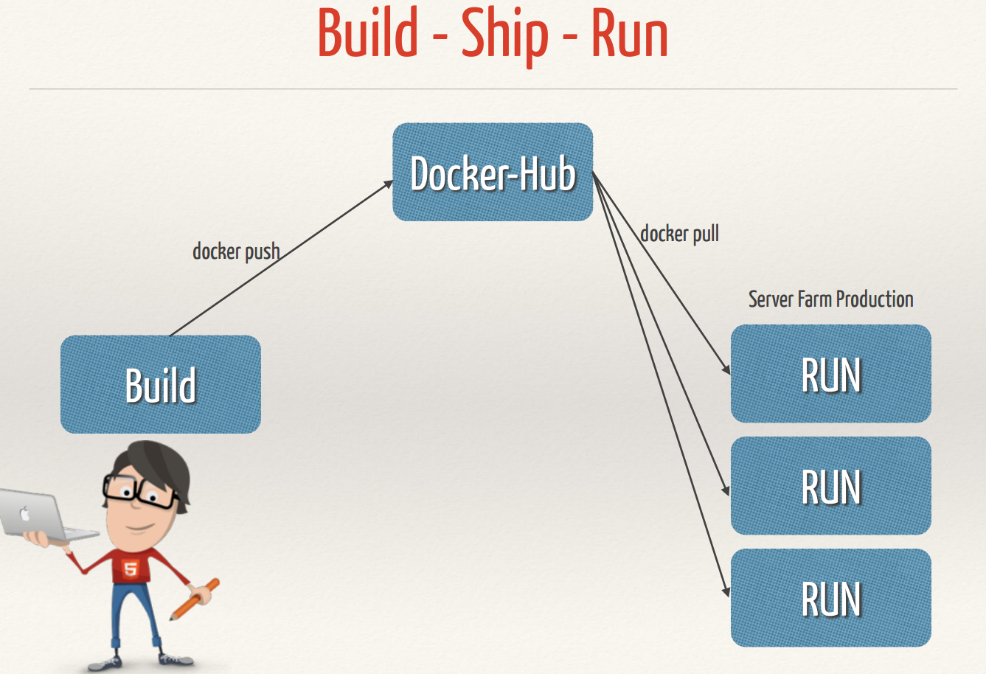

Slide 107
Build

Slide 108
Build Docker Images
Dockerfile
FROM ubuntu:14.10 MAINTAINER Romin <romin.irani@xoriant.com> RUN apt-get update RUN apt-get install -y --force-yes -q nginx COPY index.html /usr/share/nginx/html/ ENTRYPOINT ["/usr/sbin/nginx","-g","daemon off;"] EXPOSE 80
Build – Dockerfile
docker build –t rominirani/nginx:1.0.0 .
This will result in a Docker Image: rominirani/nginx:1.0.0

Slide 109
Ship

Slide 110
Ship Docker Image
docker push rominirani/nginx:1.0.0

Slide 111
Run

Slide 112
Fetch a Docker Image
docker pull rominirani/nginx:1.0.0

Slide 113
Run a Docker Container
docker run rominirani/nginx:1.0.0

